Slide 1
SCIBU5.4 Interim Structured Authoring for UK Specs
End to End Demo
SCIBU5.4 Interim Structured Authoring for UK Specs

Slide 2
End to End Demo
End to End Workflow
WordWorks XML Generation
Target XML: WordWorks to IQS Transformation
SCIBU5.4 Interim Structured Authoring for UK Specs

Slide 3
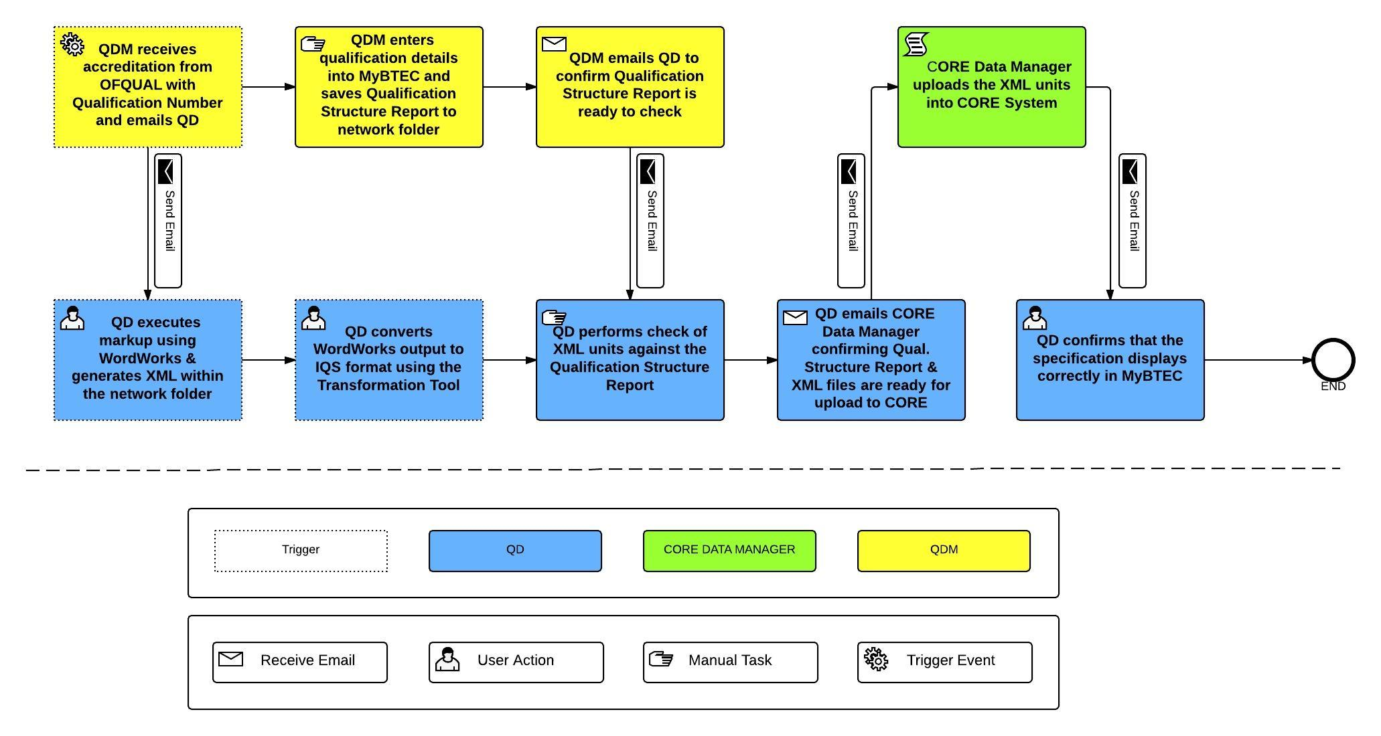
WordWorks Workflow
SCIBU5.4 Interim Structured Authoring for UK Specs

Slide 4
WordWorks: Generate XML
Dawud
SCIBU5.4 Interim Structured Authoring for UK Specs

Slide 5
Target XML Transformation:
IQS Format
Dawud
SCIBU5.4 Interim Structured Authoring for UK Specs

Slide 6
End to End Demo
Questions?
SCIBU5.4 Interim Structured Authoring for UK Specs

